Slide 1
TASK 1
ABOUT LINKEDIN

Slide 2
WHAT IS LINKEDIN?
It is a social media used by the business professionals
It is similar to other social media(FB)but it can be used only for professional purupose

Slide 3
BENEFITS
To display my resume
To learn the skills for my career
To get job alerts and internship
To recruit employees
To prepare for interviews

Slide 4
TASK 2 DATABASE AND SERVERS

Slide 5
What is database?
It is an Organised collection of data
Data can be easily accessed, managed and updated

Slide 6
Types
Relational(tabular form) ->MySQL,MariaDB,SQLite
Non relatinal(non tabular form) ->Couchbase,Redis

Slide 7
uses
Store more no of records in small space
Quick and easy to find information
Easily add,edit and delete old data
Multi person can access it at the same time
Better security

Slide 8

What is server?
It’s a program that gives services such as sharing data to another program or user(client)

Slide 9
OS used in servers:
UNIX
Linux
Windows
Red hat enterprise linux
Netware

Slide 10
Uses of server
Transfer all data through the network easily
Make connection with multiple computers
Distribute the work
Able to access data from everywhere

Slide 11
Data center
Data+ center ie place where all data is stored
It stores and process data
They are inter connected through data center inerconnect(DCI)

Slide 12
Underwater data center
For lack of space in ground
To use tidal energy
Smooth network
Less time to construct
EXAMPLE: NATICK(microsoft)

Slide 13
Task 3

Slide 14
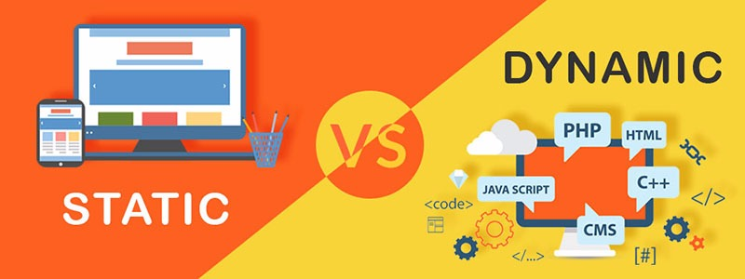
DIFFERENCE
STATIC WEBSITE | DYNAMIC WEBSITE
Contents cannot be changed(photo, video) | Content can be changed
Same content for every user | changes
User has no control to change the content | User has the control to Change the content
Example: newsletter contents | Example: e-commerce sites

Slide 15
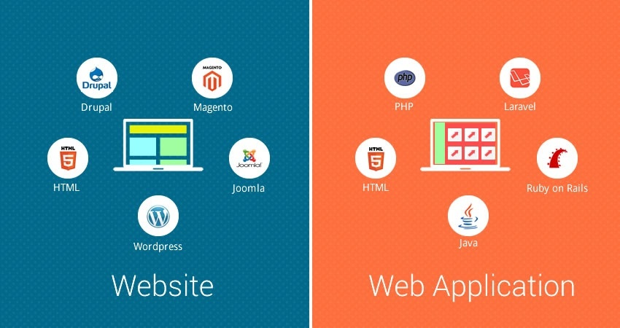
DIFFERENCE
WEBSITE | WEB APLLICATION
COLLECTION OF WEB PAGES | SOFTWARE ACCESSED BY THE USER
CONTENT CANNOT BE CHANGED | CNTENT CHANGES BASED ON USER INPUT
NOT MUCH INTERACTION WITH THE USER | MORE INTERACTION WITH THE USER
EXAMPLE: WIKIPEDIA | EXAMPLE: INSTA, FACEBOOK

Slide 16
Purpose of backend
Store and organize data
Communicates to send and receive info to display
Cannot interact with that
PHP, C++, Java, python, etc

Slide 17
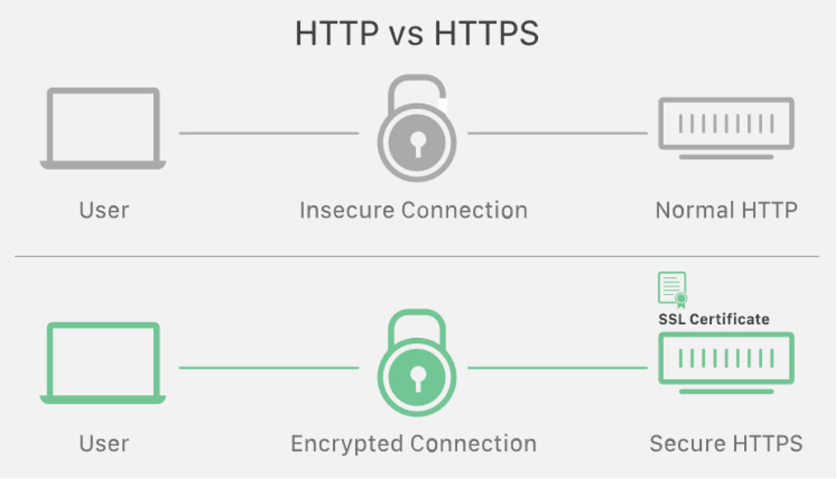
DIFFERENCE
HTTP | HTTPS
Hypertext Transfer Protocol(UNSECURE) | Hypertext Transfer Protocol Secure(MORE SECURE)
Not encrypted | Encrypted
Request and response | No hacking happens

Slide 18
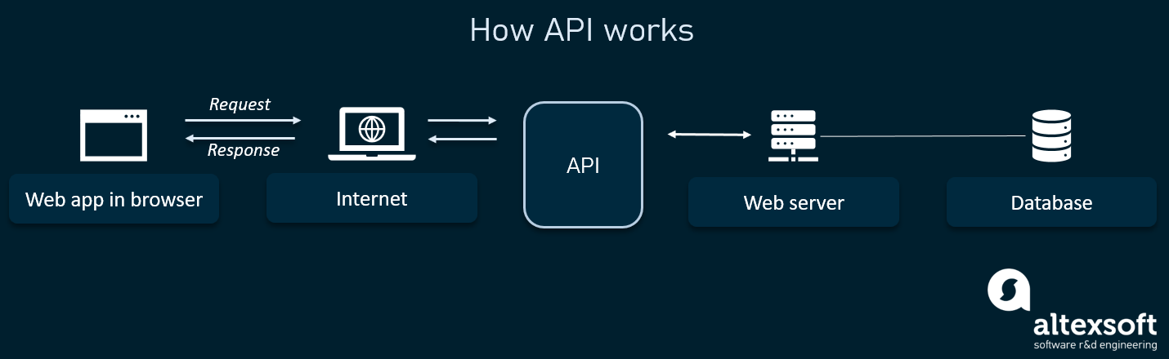
API
Application Programming Interface
It is an interface between user and web services
Ex: google map and uber
interact with a computer to retrieve information
Example: like, comment in FB

Slide 19
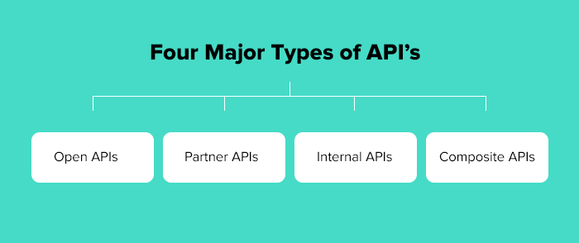
Publicly available
not available to the public
internal company purposes
access several endpoints in one call

Slide 20
REST API
uses HTTP requests to access and use data

Slide 21
REST API methods
GET request to retrieve a record
1
POST request to create one
2
PUT request to update a record
3
DELETE request to delete one.
4

Slide 22
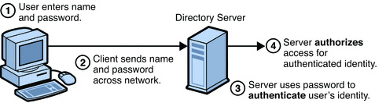
AUTHENTICATION
To recognise users identity
Example: username and Password

Slide 23
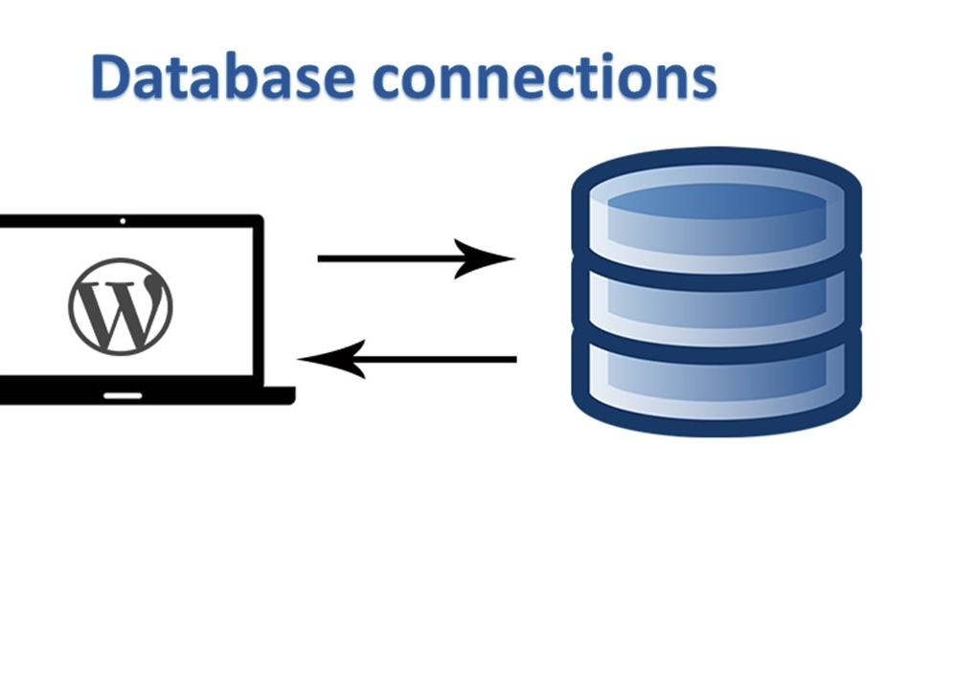
DB connection
Allows client software to talk with database server software
To send command and receive answer

Slide 24
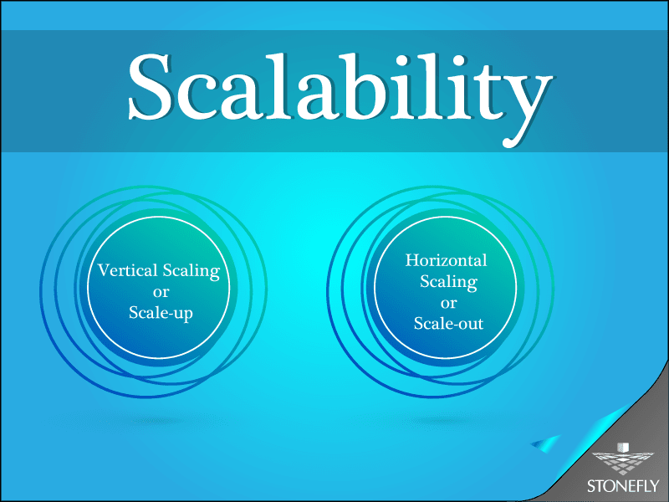
SCALABILITY
Ability to handle the increase in load without changing the performance

Slide 25

ZERO DOWNTIME
Website or web apllication doesn’t
Stop working even when the
Update or maintenance process
Is going on..

